Slide 1
COMPETE + BUSINESS VALUE
Cowork Credit Chargeback Report
Microsoft · August 2026 Synthetic sample data — no customer information.
COWORK CREDIT CHARGEBACK

Slide 2
DECISIONS SUPPORTED
The report supports decisions across cost, capacity, and allocation
Manage cost
Manage capacity
Optimize allocation
▸
Attribute per-user over-limit cost with the Chargeback KPI
▸
Identify near-limit users
▸
Increase allowance where needed
▸
Compare PAYGO, Prepaid, and Hybrid
▸
Project when demand crosses capacity
▸
Reduce unused credits
▸
See the dollar impact of model changes
▸
Model prepaid commitment scenarios
▸
Test different prepaid rules
Consumption
Prepaid + PAYGO Modeling
Forecast
Who uses credits and how much?
How should the pool be split?
When is capacity exceeded?
1
2
3
4
5
PAYGO Model
Optimization
How much is each team spending?
Who needs more—or less?
Notes:
TALK TRACK
The report supports three decisions: manage cost, manage capacity, and optimize allocation.
Under cost, the Credit Chargeback page attributes per-user over-limit cost through the headline Chargeback KPI; Billing Models separately compares PAYGO, Prepaid, and Hybrid scenarios.
Under capacity, identify near-limit users and project when demand crosses capacity.
Under allocation, right-size allowances and test how a procured prepaid pool is distributed.

Slide 3
Setting up the report
COWORK CREDIT CHARGEBACK
Notes:
SECTION DIVIDER
Transition from what the audience sees to where the numbers come from. Keep this concise: CreditCsvPath points to the Copilot credit consumption export, EntraCsvPath points to the Microsoft Entra directory export, and the report refresh joins usage to organization context.
Timing: about 15 seconds.

Slide 4
DATA INPUTS
Two familiar exports are the only required data inputs
1
2
Copilot credit consumption
Microsoft Entra directory
·
Source: Microsoft 365 Admin Center
·
Source: Entra admin center or Microsoft Graph
·
Provides per-user allowance, credits used, sessions, utilization, and activity.
·
Provides department, job title, city, country, and manager.
·
This is a single credit stream—not broken out by surface.
·
Adds the organizational context missing from the credit export.
1 · EXPORT BOTH FILES
2 · POINT AND REFRESH
3 · VALIDATE AND PUBLISH TO POWER BI
Get the Cowork Chargeback report:
https://github.com/microsoft/CreditUsage
COWORK CREDIT CHARGEBACK
Notes:
TALK TRACK
Only two familiar exports are required. CreditCsvPath points to the Copilot credit consumption export from the Microsoft 365 Admin Center. EntraCsvPath points to the Microsoft Entra directory export, which adds department, job title, city, country, and manager. Preserve the expected columns, update the paths, refresh, validate the source period, and publish. The refresh remains CSV-based and parameter-driven.
Timing: about 2 minutes.

Slide 5
POWER BI DESKTOP
Point the two parameters to the two CSV files
A routine refresh should not require a model change.
1
Open the template
Open the .pbit in Power BI Desktop.
MANAGE PARAMETERS
CreditCsvPath
2
Set CreditCsvPath
Use the full path to the consumption CSV.
C:\ApprovedData\copilot-credit.csv
3
Set EntraCsvPath
EntraCsvPath
Use the full path to the directory CSV.
C:\ApprovedData\entra-directory.csv
4
Load and refresh
Do not open the CSVs. Apply both paths, then refresh the model.
1 · EXPORT BOTH FILES
2 · POINT AND REFRESH
3 · VALIDATE AND PUBLISH TO POWER BI
COWORK CREDIT CHARGEBACK
07
Notes:
TALK TRACK
The CSV files do not need to be open. In fact, close them in Excel before refresh so Power BI can read them without a file lock. Open the template, set CreditCsvPath and EntraCsvPath to the full file paths, apply the parameters, and refresh.
For later periods, overwrite approved files in place and refresh, or update the paths through Home > Transform data > Manage parameters. Routine updates do not require a semantic-model change.
Timing: about 2 minutes.

Slide 6
GOVERNANCE
Row-level security provides the right view for finance and department leaders
1 · EXPORT BOTH FILES
2 · POINT AND REFRESH
3 · VALIDATE AND PUBLISH TO POWER BI
All org · admin
Unrestricted visibility for finance and program leads.
Department admin
A department lead sees only the departments permitted by the security filter.
Get the Cowork Chargeback report:
https://github.com/microsoft/CreditUsage
COWORK CREDIT CHARGEBACK
Notes:
TALK TRACK
Row-Level Security gives finance and program leads the All Org view, while Department Admin is scoped by the security filter. Test both roles before publishing and bind the intended groups. Workspace admins and report owners retain broad access. Pair this access check with the reporting-cycle refresh: replace the two exports, confirm CreditCsvPath and EntraCsvPath, refresh, and validate the source period and financial assumptions.
Timing: about 2 minutes.

Slide 7
Report Details
COWORK CREDIT CHARGEBACK
Notes:
SECTION DIVIDER
The report is the main walkthrough. Begin with shared controls and the correct Chargeback rule, then move through Consumption, Chargeback, Optimization & Limits, Forecast (Credits), Billing Models, Prepaid Allocation, Glossary, and the hidden FOCUS Cost View.
Timing: about 15 seconds.

Slide 8
REPORT ORIENTATION
How this report works
THE PAGES
CONTROLS ON (ALMOST) EVERY PAGE
1
Consumption — who is using credits, and how much
Slice By — regroups every rollup by Department, Business Unit, Cost Center, Job Family, Job Title, City, Country, Manager or User.
Rate per Credit — sets the dollar value of one credit (default $0.01); reprices costs live.
Usage Intensity — filters to a cohort, from Light (bottom 50%) to Frontier (top 1%).
Credit Chargeback — Shows per-user over-limit credits priced at the configured Rate per Credit.
Consumption — Compares usage with allowance; it does not determine billing.
Financial Inputs — Confirm the source period, rates, prepaid pool, and Allocation Model before use.
2
PAYGO Modeling — how much is each team spending
3
Prepaid + PAYGO Modeling — split a prepaid pool across teams
4
Optimization & Limits — who to give more - or less
5
Forecast (Credits) — project future demand vs capacity
COWORK CREDIT CHARGEBACK
Notes:
TALK TRACK
The pages follow a decision path: Consumption shows usage versus allowance; Credit Chargeback isolates the per-user over-limit cost KPI; Optimization and Forecast address capacity; Billing Models compares PAYGO, Prepaid, and Hybrid scenarios; Prepaid Allocation distributes a procured pool and shows coverage versus PAYGO gap. These are related views, not one combined calculation.
Slice By changes the organizational lens. Rate per Credit reprices dollar measures without changing usage. Usage Intensity narrows the selected cohort.
Timing: about 2 minutes.

Slide 9
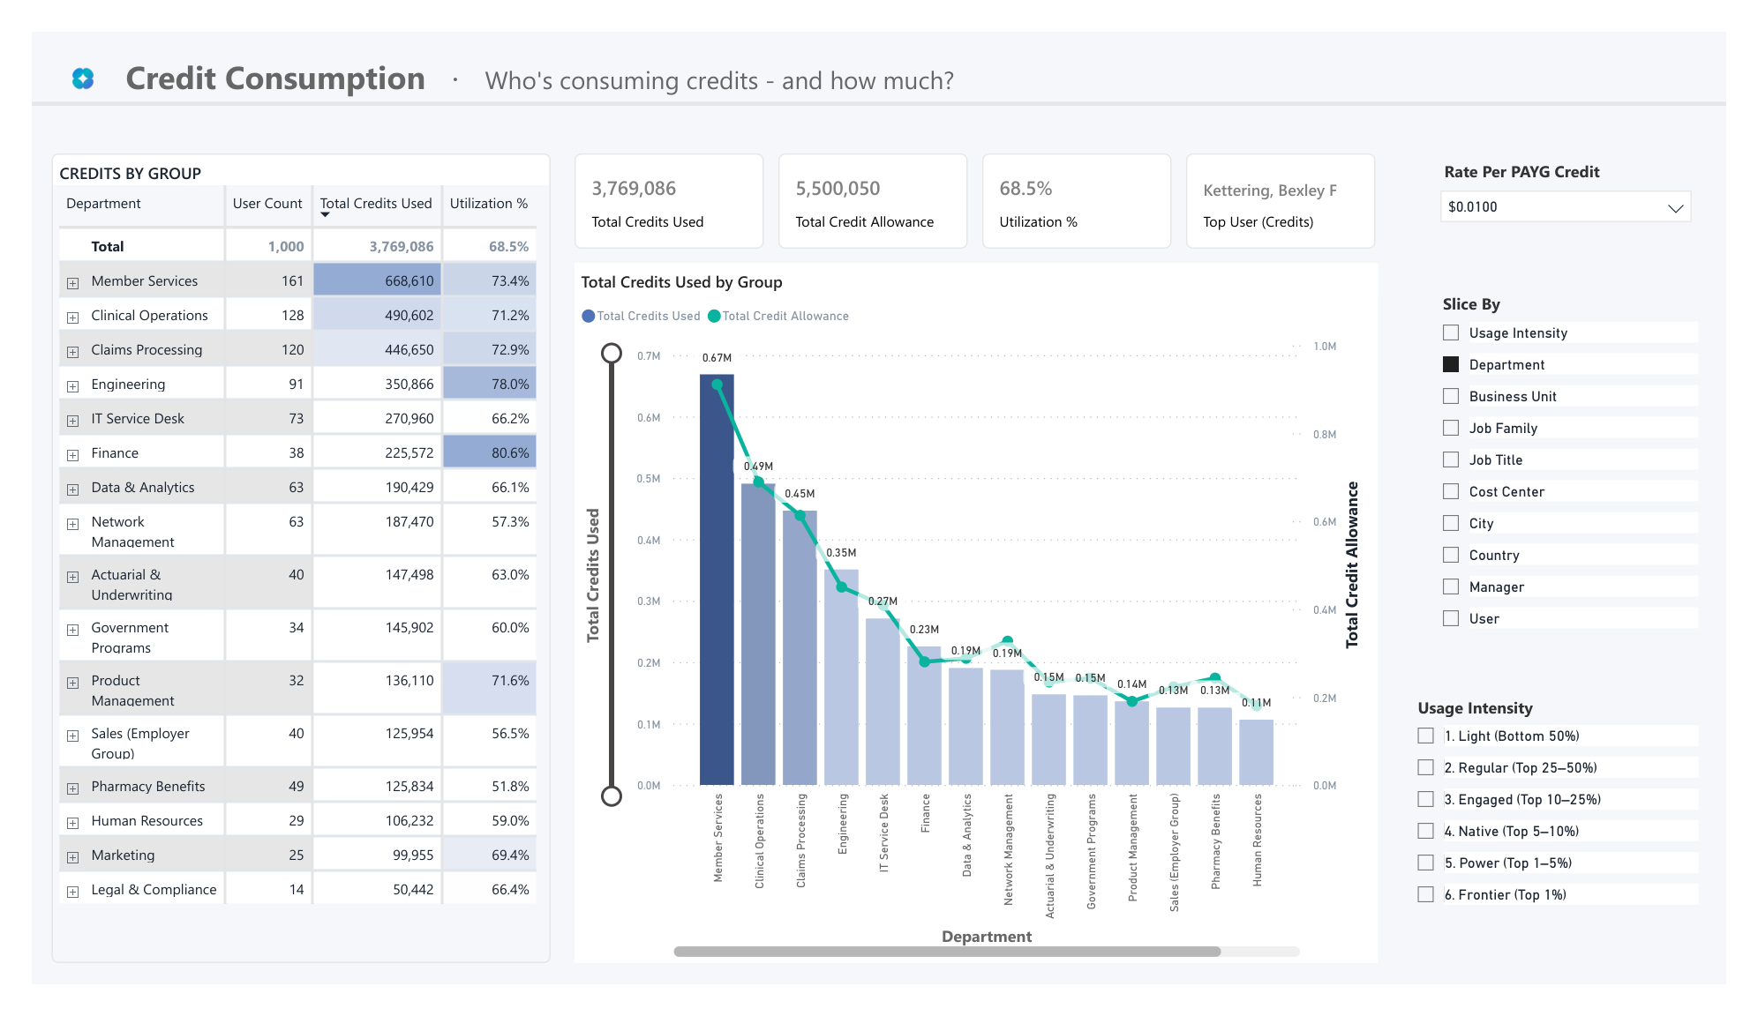
1
Consumption
Who's consuming credits — and how much?
CREDIT CONSUMPTION
HOW TO READ THIS PAGE
1
SET THE VIEW
3
Choose the period, rate, Slice By, and Usage Intensity.
2
1
2
CHECK ALLOWANCE
Read credits used, total allowance, and utilization.
3
SPOT DEPARTMENTS
Compare usage with allowance to find groups above, near, or below it.
HOW TO TAKE ACTION
Identify departments that are consistently exceeding their allowance, then drill into the individual users driving consumption. Use these insights to determine whether allowances should be increased, rebalanced, or maintained.
COWORK CREDIT CHARGEBACK
Notes:
TALK TRACK
WHAT THIS PAGE IS FOR
Compare each department's credit use with its allowance and see who is above, near, or below it.
WHAT TO LOOK FOR
Scan department totals, then expand a department to inspect individual usage. A department can be under its aggregate allowance while individual users are over their limits.
WHAT ACTION TO TAKE
Expand an over-limit department, identify the users driving demand, and target allowance increases only where the detail supports them.
Timing: about 2 minutes.

Slide 10
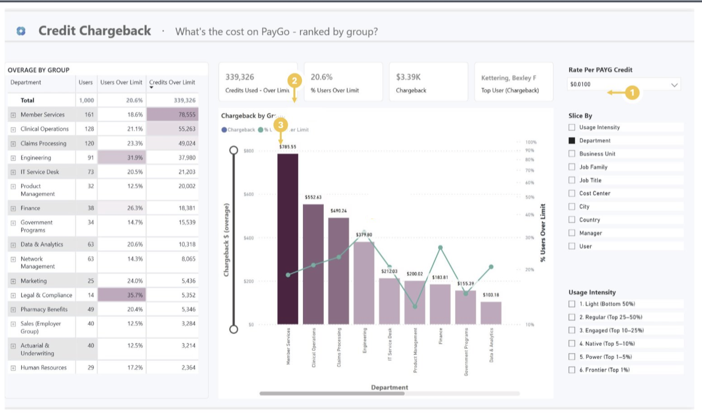
2
PAYGO Modeling
What is the PAYGO cost, ranked by group?
PAYGO MODELING
HOW TO READ THIS PAGE
1
SET THE RATE
Confirm Rate per PAYG Credit, Slice By, and Usage Intensity.
2
READ OVERAGE
Read credits and users over limit, then overage-only Chargeback.
3
COMPARE GROUPS
Rank cost and use % Users Over Limit to judge breadth.
HOW TO TAKE ACTION
Understand which teams are generating the highest chargeback exposure. Review the users contributing to overages and use the results to support billing discussions and cost accountability conversations.
COWORK CREDIT CHARGEBACK
Notes:
TALK TRACK
WHAT THIS PAGE IS FOR
Model PAYGO Chargeback at the configured rate. Chargeback is overage-only, not full-consumption cost.
WHAT TO LOOK FOR
Read credits over limit, % Users Over Limit, and Chargeback. Compare the bars with the line to distinguish concentrated outliers from broad exposure.
WHAT ACTION TO TAKE
Use overage-only Chargeback to allocate the monthly bill and focus manager follow-up on the groups driving it.
Timing: about 2 minutes.

Slide 11
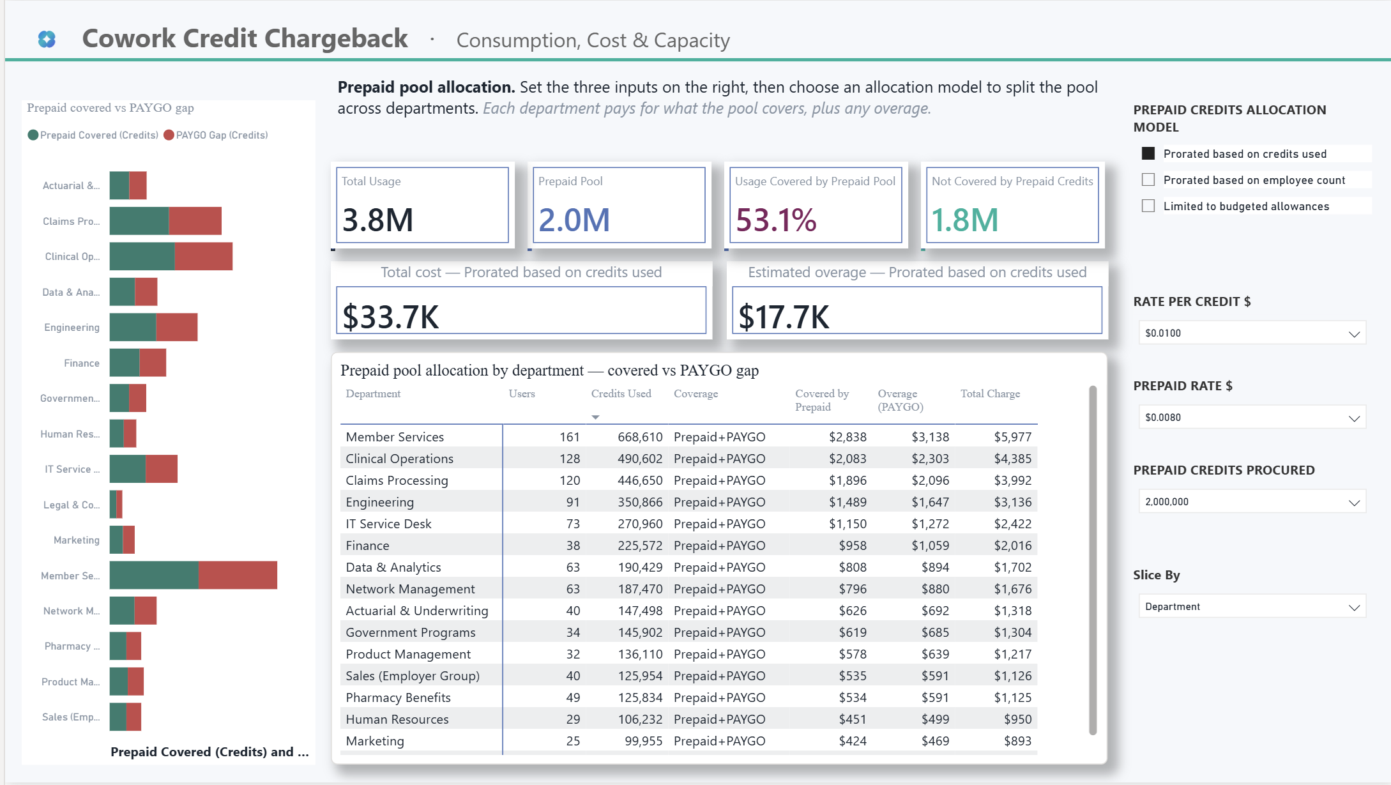
3
Prepaid + PAYGO Modeling
How do we split a prepaid pool across teams?
PREPAID + PAYGO MODELING
HOW TO READ THIS PAGE
1
CHOOSE ALLOCATION
1
Set rates and prepaid pool, then choose an allocation model.
2
3
2
CHECK COVERAGE
Read total usage, pool coverage, and credits not covered.
3
COMPARE IMPACT
Compare prepaid coverage, PAYGO overage, and total cost by team.
HOW TO TAKE ACTION
Compare allocation models to understand how prepaid credits are distributed across teams. Use the results to select the allocation approach that best aligns with your organization's budgeting and chargeback strategy.
COWORK CREDIT CHARGEBACK
Notes:
TALK TRACK
WHAT THIS PAGE IS FOR
Test how a prepaid pool is allocated and where PAYGO gaps remain.
WHAT TO LOOK FOR
Toggle Prorated based on credits used, Prorated based on employee count, and Limited to budgeted allowances. Compare prepaid coverage, PAYGO overage, and total cost by team.
WHAT ACTION TO TAKE
Choose the allocation policy that matches the operating model, size the prepaid pool, and budget for remaining PAYGO overage.
Timing: about 2 minutes.

Slide 12
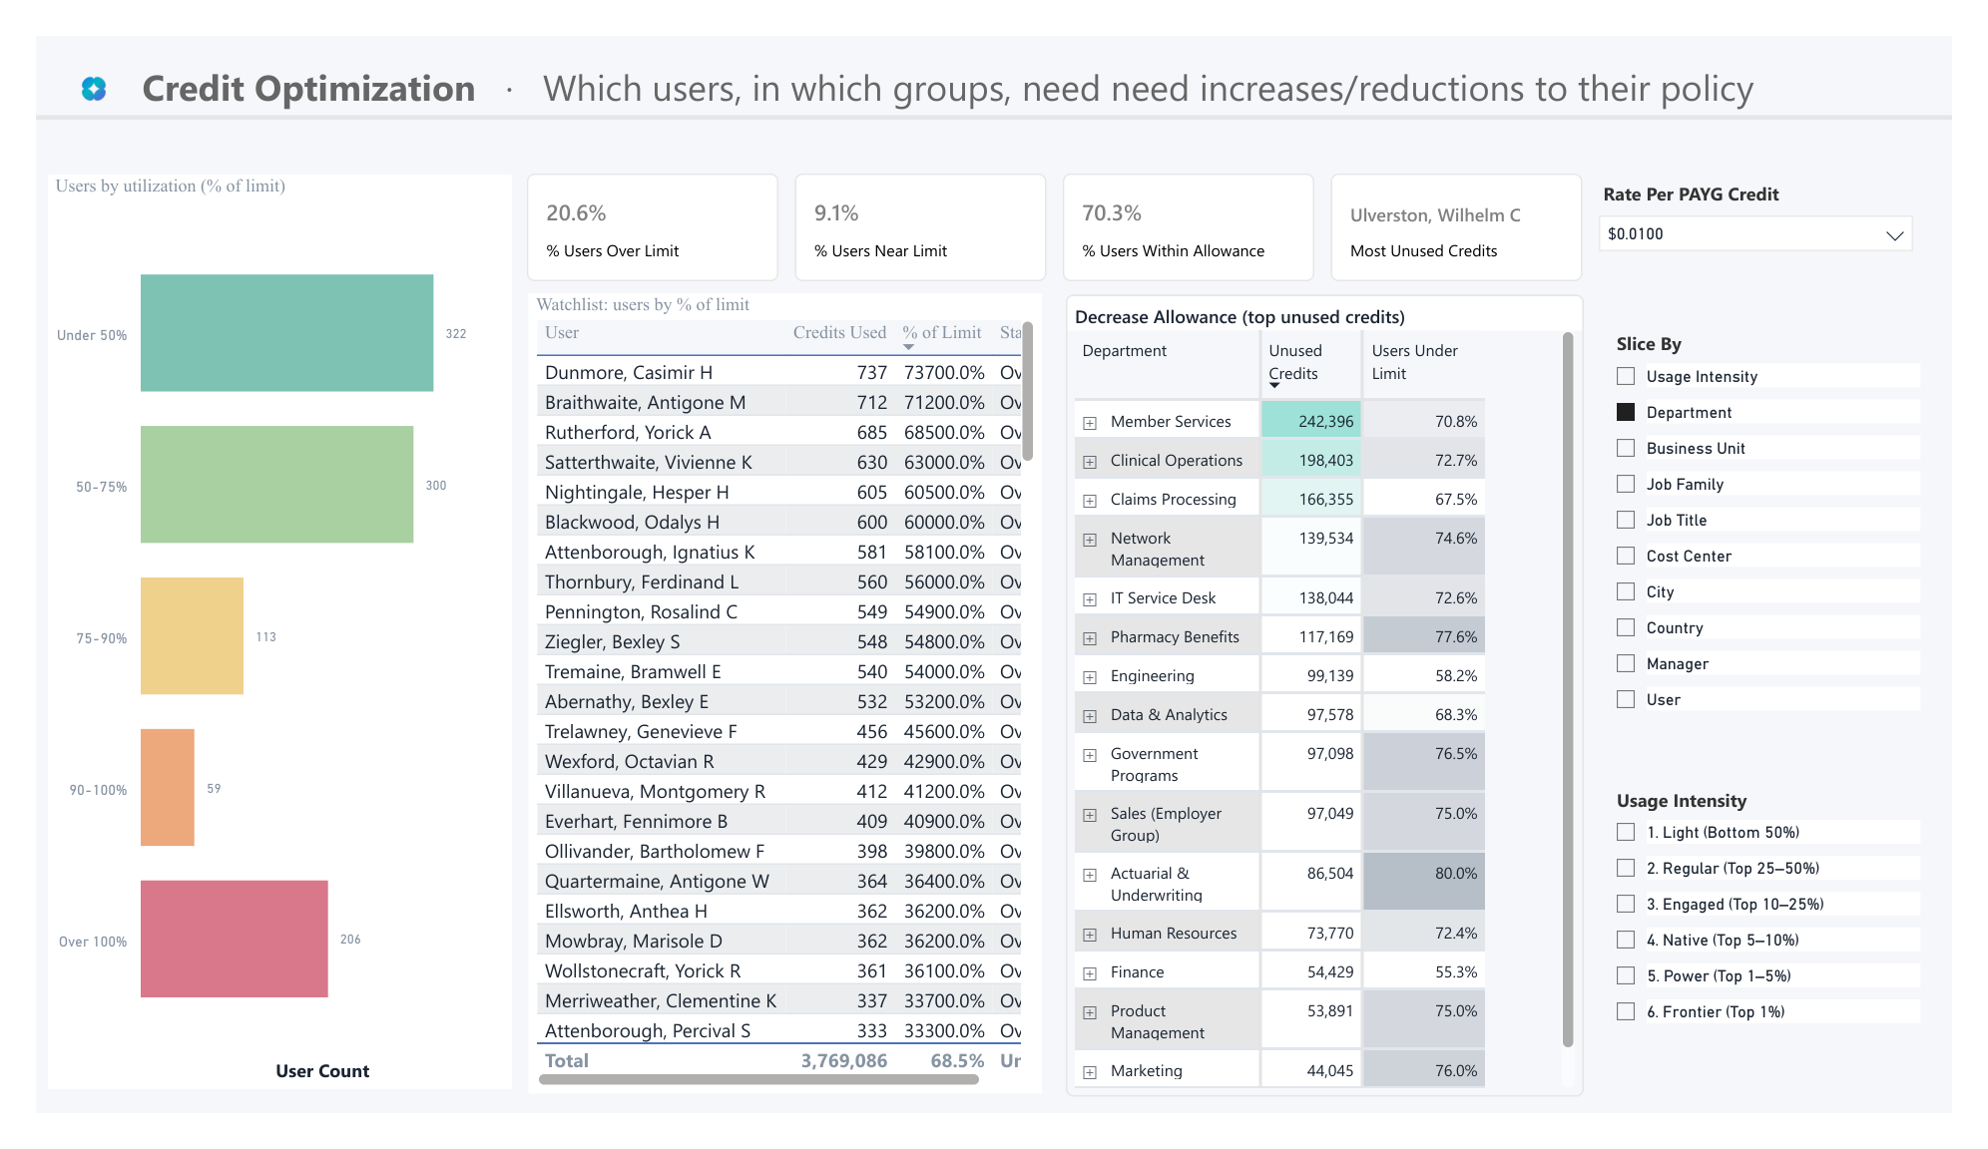
4
Optimization & Limits
Who needs a bigger — or smaller — allowance?
CREDIT OPTIMIZATION
HOW TO READ THIS PAGE
1
SET THE VIEW
2
Confirm rate, Slice By, and Usage Intensity.
1
2
CATCH USERS EARLY
Scan near-limit and over-limit bands before month-end.
3
3
REVIEW CANDIDATES
Compare the user watchlist with unused credits by group.
HOW TO TAKE ACTION
Proactively engage users nearing their limits to understand how Cowork is being used. Use these insights to identify automation opportunities, validate business demand, and adjust allowances before overages occur.
COWORK CREDIT CHARGEBACK
Notes:
TALK TRACK
WHAT THIS PAGE IS FOR
Catch near-limit and over-limit users before month-end and identify allowances that may not match sustained demand.
WHAT TO LOOK FOR
Scan the 90-100% and over-100% bands, then review the user watchlist and unused credits by group. Investigate role, workflow, automation pattern, and seasonality.
WHAT ACTION TO TAKE
Contact near-limit users before month-end; approve justified boosts and reclaim credits that remain consistently unused.
Timing: about 2 minutes.

Slide 13
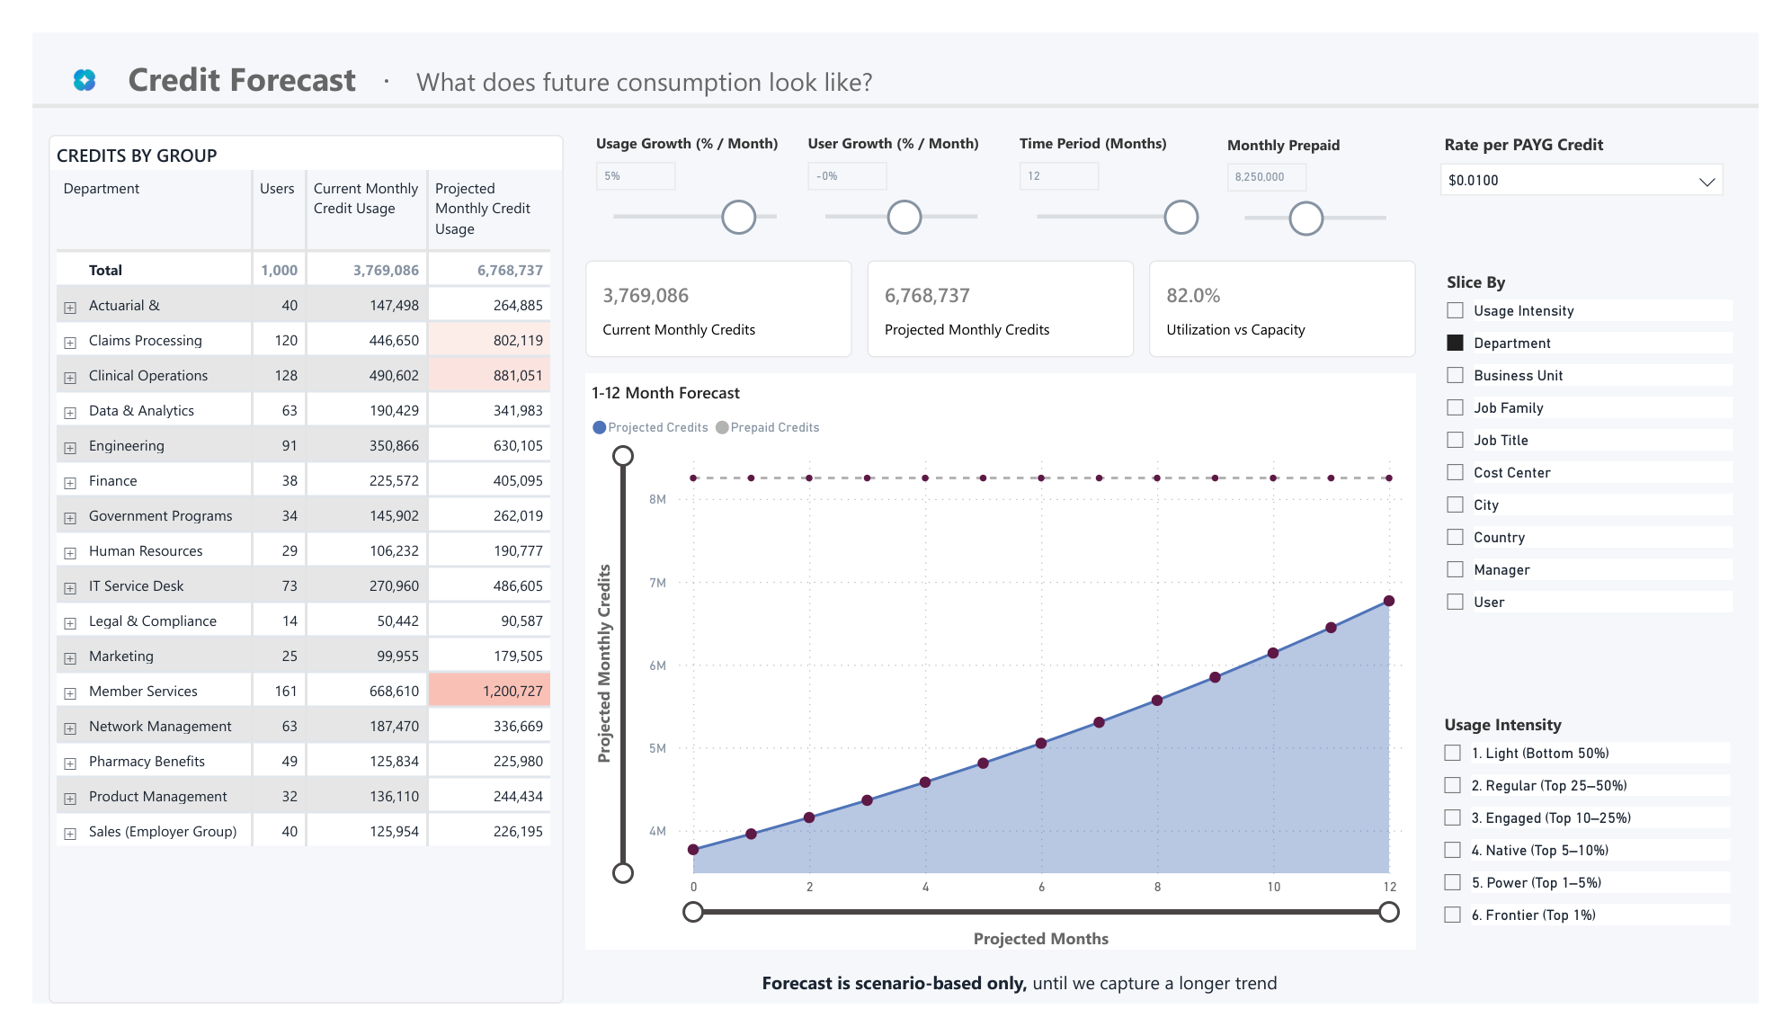
5
Forecast (Credits)
What does future consumption look like?
CREDIT FORECAST
HOW TO READ THIS PAGE
1
SET THE SCENARIO
Set horizon, growth, prepaid capacity, and rate assumptions.
1
2
2
READ THE OUTLOOK
Compare current and projected credits plus capacity utilization.
3
3
TEST CAPACITY
Compare projected demand with prepaid capacity month by month.
HOW TO TAKE ACTION
Identify when demand may exceed available capacity. Leverage the 3-, 6-, 9-, and 12-month views to plan budgets, evaluate credit needs, and avoid future capacity constraints.
COWORK CREDIT CHARGEBACK
Notes:
TALK TRACK
WHAT THIS PAGE IS FOR
Test future credit demand against prepaid capacity over a selected horizon. This is a scenario, not a prediction.
WHAT TO LOOK FOR
Compare current and projected credits, Utilization vs Capacity, and the demand curve against the prepaid line. Note whether and when demand approaches or exceeds capacity.
WHAT ACTION TO TAKE
Compare 3-, 6-, 9-, and 12-month scenarios and schedule a capacity review before projected demand reaches the prepaid commitment.
Timing: about 2 minutes.

Slide 14
Web Apps
COWORK CREDIT CHARGEBACK
Notes:
SECTION DIVIDER
The report is the main walkthrough. Begin with shared controls and the correct Chargeback rule, then move through Consumption, Chargeback, Optimization & Limits, Forecast (Credits), Billing Models, Prepaid Allocation, Glossary, and the hidden FOCUS Cost View.
Timing: about 15 seconds.

Slide 15
Interactive HTML
Live in the browser, on the customer’s own export. Nothing is uploaded.
CHARGEBACK
Allocation insights
POLICY HELPER
Review billing policy
FINOPS & FOCUS COST
Cost insights
HTML app
HTML app
HTML app
Every report runs on the same two files:
Cowork consumption export (Microsoft admin center)
Organizational data (Entra)
https://microsoft.github.io/Analytics-Hub/cowork-billing/
Notes:
Section three. Three tools, one shared pair of inputs, and the whole thing opens in a browser tab. Say the two headline points before anything else. First, there is a live interactive demo, so you can click into it on a call without provisioning anything. Second, no customer data ever leaves the tenant. The apps are plain HTML and JavaScript running client-side; the file the customer picks is parsed in browser memory and cached there. Nothing is posted to a server, there is no backend, and closing the tab clears it. That answers the security question before it gets asked, and it is usually the question that decides whether you get a second meeting. Then the picker: Chargeback answers bill this department and is the only one with a Power BI version. FinOps answers show Cowork next to our other cloud spend, so reach for it when the customer already has a FinOps practice. Policy Helper is the follow-up to either. The Usage Tracker that used to sit here is retired, superseded by the Consumption Dashboard in Viva Insights on slide five.

Slide 16



Interactive HTML
What to know
WHY: A customer asks what Cowork is costing each department and there is no answer that finance will accept. These apps turn the export they already have into that answer, in a browser tab, in a few minutes.
Nothing leaves the tenant
Nothing to install
Exports at every step
Pure client-side HTML. The file is parsed in browser memory and cached there. No backend, no upload, no telemetry on customer data. Close the tab and it is gone.
A public URL and a live interactive demo loaded with sample data. Open it on a call, click through it, then swap in the customer file. No provisioning, no license, no IT ticket.
Every view exports. CSV for finance, the full workbook for analysts, and a one-page summary to send on. The customer leaves the call holding something.
What it is NOT: a billing system of record. The Microsoft 365 admin center remains the invoice. These make the invoice explainable and allocable.
Notes:
The enablement slide. Lead with the objection you will actually hit, which is security, and kill it in one line: the apps are client-side HTML, the customer's file is parsed in browser memory, there is no backend to post to and closing the tab clears it. Nothing leaves the tenant. Say it plainly and early, because until that lands nobody hears the rest. Second point is friction. There is a public URL with a live demo already loaded with sample data, so you can run this on a Teams call today with no provisioning and no licence. That is the difference between a demo this week and a demo next quarter. Third is exports, and this is the one people underestimate. Every view exports to CSV for finance, to a workbook for analysts, and to a one-page summary for the exec. The customer walks away holding an artifact, which is what turns a demo into a follow-up meeting. Be honest about the boundary: this is not a system of record. The Microsoft 365 admin center is still the invoice. These tools make that invoice explainable and allocable, and saying so up front buys you credibility.

Slide 17
Interactive HTML
How to run the reports
Open the app and click Load demo data to walk the customer through it first
Pull the Cowork consumption export from the Microsoft 365 admin center (CSV)
Pull organizational data from Entra: user, department, cost center (CSV)
Drop both files onto the page, map the cut-by column, then export
microsoft.github.io/Analytics-Hub/cowork-billing/
Notes:
Walk this as a live demo rather than reading it. Step one matters most: open the app and hit Load demo data, so the customer sees a populated report before you ask them for a single file. People say yes to something they have already seen working. Steps two and three are the only prerequisites, and they are the same two files for all three tools. The Cowork consumption export comes out of the Microsoft 365 admin center. The org file comes from Entra and needs user, department and cost center. If the customer has cost centers in Workday or SAP rather than Entra, that export works too, it just needs the user identifier to match. Step four is the moment worth pausing on. The files are dropped onto the page, not uploaded, and the report renders in seconds on their own machine. Step five: map the cut-by column once and everything downstream follows it. Then export. One practical note: if the customer cannot share the export on the call, send them the link and let them run it themselves. It works exactly the same and they never have to hand you data.

Slide 18





Interactive HTML
What you get out — and who it is for
WHO USES EACH EXPORT
CSV export
Finance and billing — drops into the month-end journal or the internal billing system without rekeying.
THE MAIN OUTPUT
Full workbook export
The allocation table
Analysts — every row behind the summary, so they can rebuild the cut their own way and check the maths.
WHAT THE CUSTOMER TAKES AWAY
One-page summary
Cowork spend split by department, cost center and person, reconciled to the invoice — the artifact finance has been asking for. Exports straight to CSV.
Executives — a single shareable page with the headline numbers, ready to forward without editing.
Policy roster export
IT and AI admins — a point-in-time record of who sat on which spending policy, for audit and for the next review cycle.
Notes:
Close the section on outputs, because that is what the customer actually keeps. The allocation table is the main event: Cowork spend split by department, cost center and person, reconciled against the invoice. That is the artifact finance has been asking for and could not produce. Then match the export to the person in the room, because handing the wrong one out is how these stall. Finance wants the CSV, it goes straight into the month-end journal with no rekeying. Analysts want the full workbook, because they will not trust a summary they cannot rebuild, and giving them every row buys trust fast. Executives want the one-page summary, and the reason that one matters is it gets forwarded. That is how this spreads inside an account without you in the room. IT and AI admins want the policy roster, which is the point-in-time record of who was on which policy, and it is what they need at audit. Practical close: send the hub link, ask whether they need to bill a department or see all AI spend in one place, and let that answer pick the app. These carry the weekly checkpoints in weeks four to six and the evidence you need at closeout.

Slide 19
Questions?
Please share customer feedback!
COWORK CREDIT CHARGEBACK
Notes:
TALK TRACK
Close by offering next steps: share the Cowork Chargeback report link, walk through the two CSV exports, or validate Rate per Credit, prepaid assumptions, Allocation Model, and source period. Restate the key distinction: the Credit Chargeback headline KPI is per-user over-limit cost; Billing Models and Prepaid Allocation are separate scenario views.
Timing: open-ended.

